Slide 1
A randomized control trial to study the effectiveness of the Mobile Functional Cognition Program for persons who have substance abuse
Project Title:
Project Reference Number: BDF 160032 Organization: United Christian Hospital

Slide 2
CONTENT
Introduction
Method
Results
Discussion

Slide 3
1. INTRODUCTION

Slide 4
Substance use disoder (SUD): a community issue
Community health issue in personal, social, financial perspectives
4129 reported drug abusers in first quarters of 2020 in HK (Narcotics Division, Security Bureau, 2020)
Increasing trend in younger drug abusers (HKSAR, 2019; Legislative Research Office, 2019)
Affects cognitive and general everyday functioning in individuals (Leung, 2015)

Slide 5
SUD affects Functioning
Type of drugs | Function affected
Heroin (Tolomeo et al., 2020) | Deficited cognitive abilities: memory cognitive impulsivity no planning impulsivity compulsivity decision making
Ketamine (Morgan & Curran, 2012; Chan et al., 2013) | Deficit in working and episodic memory Selective deficits in frontal and medical temporal functioning → verbal information processing → cognitive processing speed

Slide 6
SUD affects functioning (cont’d)
Type of drugs | Function affected
Amphetamine (Rogers et al., 1999; Fermandez-Serrano, 2011) | Prominent impairment: → visual-spatial memory and processing → visual planning → pattern recognition memory
Cocaine (Sudai et al., 2011) | Impairment: → short-term verbal memory → visuospatial ability → working memory

Slide 7
Review of SUD Cognitive Training
Goal Management Training and Mindfulness Medication (Valls-Serrano et al., 2016)
→ improve working memory (of polysubstance users)
Cognitive rehabilitation treatement (Rezapour et al., 2019)
→ executive function (of opioid use disorder)
Cognitive Remedial Treatment and Contigency Management (Kiluk et al., 2017)
→ enhance cognitive function
However…
Limited numbers of studies
Hong Kong has no particular program

Slide 8
The Mobile Functional Cognition Program (MFCP)
2 years pioneer program
Launched by Occupational Therapists in United Christian Hospital
July 1, 2015 – June 30, 2017
Simple pre- and post design
Preliminary positive results

Slide 9
Research aim and hypothesis
Aim: To study the effectiveness of the MFCP.
Hypothesis: Participants who receive the MFCP would improve their cognitive and everyday functioning compared to those who receive social activities.

Slide 10
2. METHOD

Slide 11
Study design
A multi-center randomized controlled trial
Conducted between September 1, 2017 and January 31, 2021

Slide 12
Participants
Sample size estimation:
Based on our pilot in 2015–17, assume the effect size is 0.4
Sample size estimation: 50 in each arm
Consider attrition: recruit 60 in each arm
A total of 134 participants recruited:
Counselling Centers for Psytropic Substance Abusers (CCPSAs)
Drug Treatment and Rehabilitation Centers (DTRCs)
Methadone Clinic and
Substance Abuse Clinic at UCH

Slide 13
Participants
Inclusion: History of substance abuse in the past 12 months
⇒ willing to receive assessment and training in functional cognition
Exclusion: not mentally and medically stable
Final sample after attrition:
→ 53 in experimental group
→ 57 in control group

Slide 14
Procedures
Recruitment & Randomization
Baseline Assessment
Intervention
After Treatment Assessment
Experimental group: MFCP
NCSE (cognitive)
COPM (function)
MFCP
NCSE
COPM
Control group: Social activities
Social Activities

Slide 15
Assessments
Neurobehavioural Cognitive Status Examination (NCSE)
Cognitive assessment
Assesses 5 major cognitive abilities: language, spatial skills, memory, calculations, and reasoning
Detect cognitive impairment and measure treatment outcomes on substance abusers
Canadian Occupational Performance Measure (COPM)
Assess participants’ self-perceived everyday functioning
Semi-structured interviewing tool measuring all life areas: self-care, leisure, productivity
Individuals’ perceptions of the importance and performance→ rated on 10-point Likert scale
Proven to be valid, reliable, practical, and responsive outcome measure

Slide 16
MFCP
Experimental group: MFCP
8 sessions of MFCP:
90 mins each session
Included:
Psychoeducation
Teaching strategies for coping with cognitive deficits
CogniPlus training
53 Participants

Slide 17
MFCP Course content
Part 1 | One session on pre-assessment and recovery planning (1.5 hours): Assessment on cognitive and occupational functioning Psychoeducation on neuropsychological impact of substance abuse
Part 2 | Core content of mobile functional cognition training (1.5 hours each session): Part 1 Computerized cognitive training using Cogniplus (30 minutes) Part 2 Psychoeducation (45 minutes) Definition of cognitive function Relationship between substance abuse and cognitive function Functional cognitive strategies Cognitively Active Lifestyle Redesign Emotional regulation Sleep management Part 3 Practical session of cognitive active lifestyle: Health Qigong (Baduajin Training)/ Cognitive stimulating group activities (15 minutes) *** Paper and pencil cognitive stimulating homework assignment after each session
Part 3 | One session of post-assessment and round up (1.5 hours): Assessment on cognitive and occupational functioning Feedback on the progress in the functional cognitive training Round up and prepare for discharge

Slide 18
MFCP
CogniPlus training (Developed by SCHUHFRIED):
Computerized training system, resembles some actual daily activities
Automatically adapt the training level to suit the participants’ performance levels
Covers attention, visual-field training, working memory, long-term memory, executive functions, spatial processing, and visuomotor skills.
Experimental group: MFCP
53 Participants

Slide 19
Social Activities
8 sessions of social activities:
3 to 6 participants each session
90 mins each session
Broad games or art and craft activities
Control group: Social activities
57 Participants

Slide 20
3. RESULTS

Slide 21
Sociodemographic data of the sample
No difference in age, sex, and education level across the groups

Slide 22
Cognitive and functional performances of the sample
No difference in baseline NCSE and COPM scores across the groups
Repeated measure ANOVA: The MFCP had no greater effect over the social activities
Post hoc Schèffe test: The MFCP had significantly improved the experimental group’s NCSE and COPM scores; similar pattern occurred in the control group

Slide 23
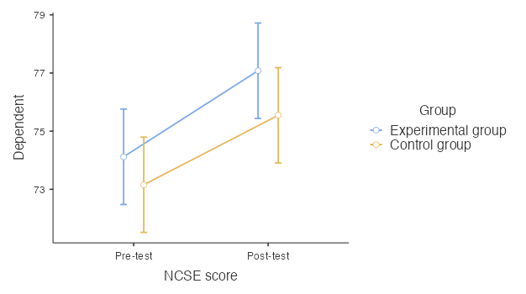
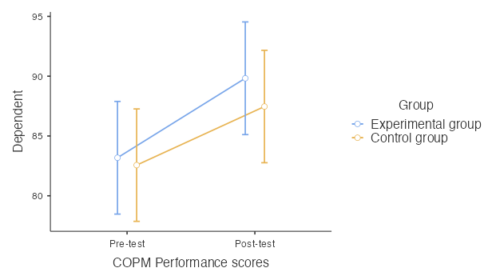
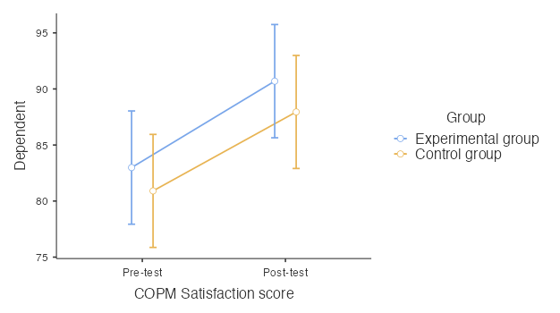
Plots of cognitive and functional performances of the sample
Both experimental (MFCP) and control group (social activities) show improvement

Slide 24
Effect Size of Experimental (MFCP) against Control (Social Activities)
The MFCP appeared to have slight advantage over social activities

Slide 25
4. DISCUSSION

Slide 26
Our Hypothesis and Recent Research
Our finding: both MFCP and social activities improved cognitive and functioning.
It concurs with observations in our 2015–17 pilot that the MFCP improves cognitive abilities.
No other MFCP study so far.
There are reports of positive effect of social activities on cognitive functioning (Cohn-Schwartz, 2020; Kelly ME et al, 2017; Li H et al., 2020).
In our study, MFCP seems having a slight advantage over social activities; we may need longitudinal study to verify.

Slide 27
Limitations
Therapists had to visit various centers to carry out the project
⇒ it was difficult to control the experiment between treatment sessions.
DTRC staff reported that some control group participants asked their roommates and completed the experimental groups’ assignments
⇒ confound the results of the research
Did not apply a longitudinal study design
Further evidence on cognitive training for SUD is necessary

Slide 28
Conclusion
This study and our pilot (2015–17) support that the MFCP is practical and easy to use.
Further study is needed to verify if the MFCP is better than social activities in improving cognition and functioning.

